Slide 1
Quantitative Risk Management Lecture 7: Counterparty Risk
Roy E. DeMeo, Jr.

Slide 2
What is Counterparty Risk?
Counterparty Risk accounts for the risk that a company that your bank does business with doesn’t pay you, i.e. defaults. This can happen any time the net value of your position with that company, or counterparty, is > 0, and is not covered by collateral, which is money or assets set aside by the counterparty in advance to cover what it owes you. Just in case…

Slide 3
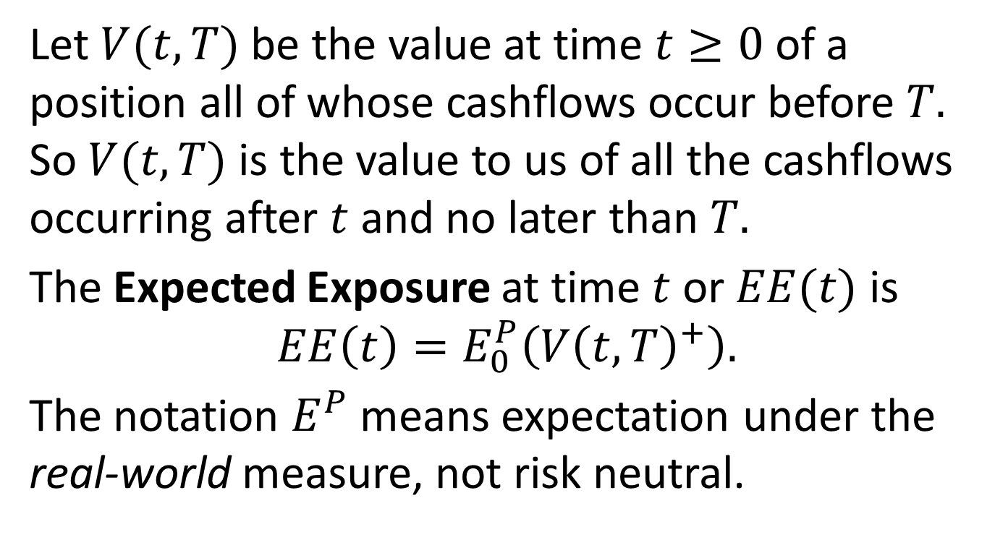
Types of Exposure
Let $V(t,T)$ be the value at time $t≥0$ of a position all of whose cashflows occur before $T.$ So $V(t,T)$ is the value to us of all the cashflows occurring after $t$and no later than $T.$
The Expected Exposure at time$t$ or $EE(t)$ is
$$EE\left(t\right)=E_{0}^{P}\left(V{\left(t,T\right)}^{+}\right).$$
The notation $E^{P}$ means expectation under the real-world measure, not risk neutral.

Slide 4
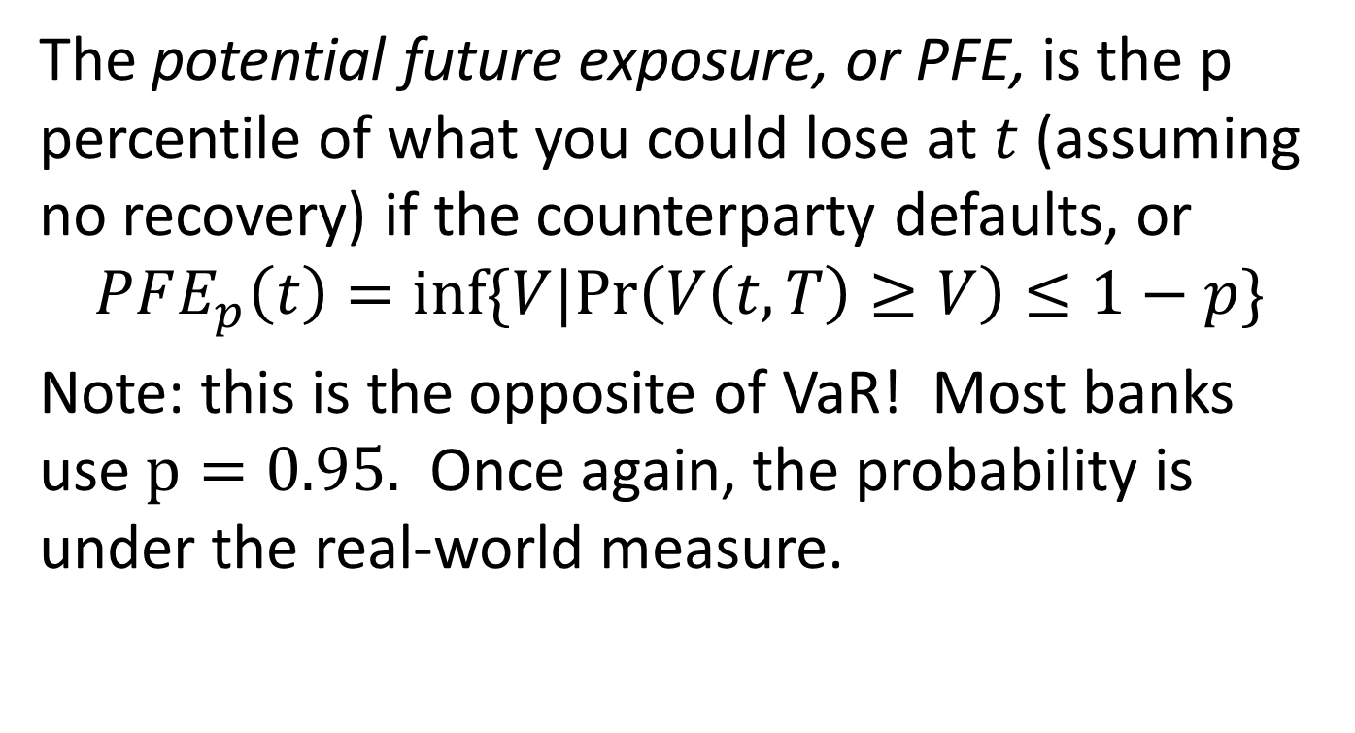
Types of Exposure, cont’d
The potential future exposure, or PFE, is the p percentile of what you could lose at $t$ (assuming no recovery) if the counterparty defaults, or
$$PFE_{p}\left(t\right)=inf⁡\{V|Pr\left(V\left(t,T\right)≥V\right)≤1−p\}$$
Note: this is the opposite of VaR! Most banks use $p=0.95.$ Once again, the probability is under the real-world measure.

Slide 5
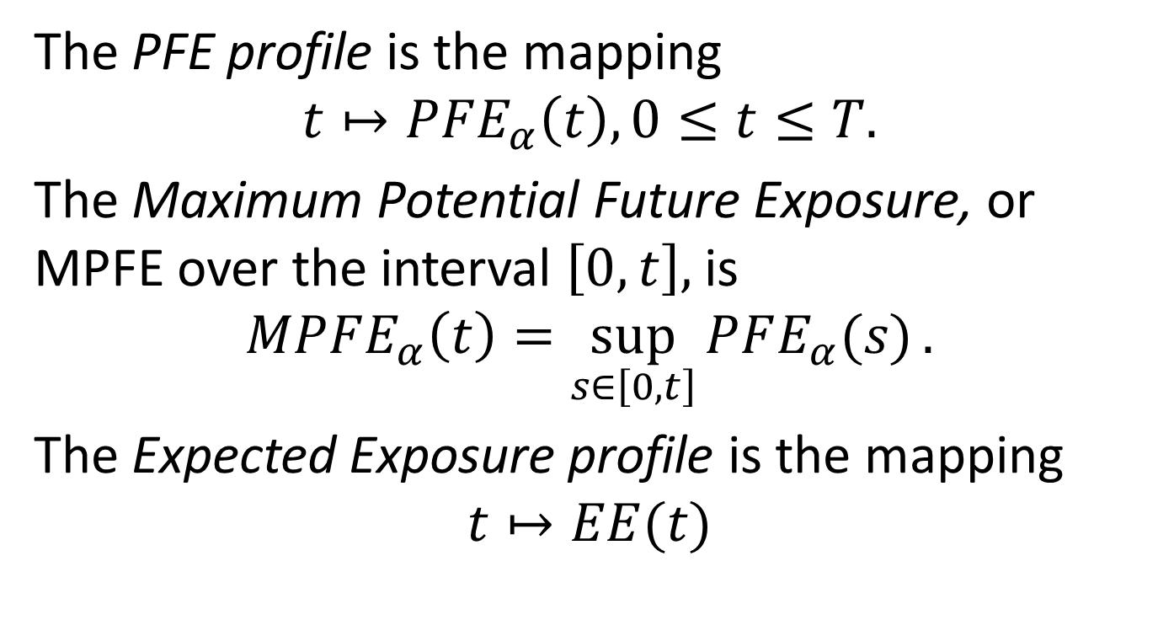
Types of Exposure, cont’d
The PFE profile is the mapping
$$t↦PFE_{α}\left(t\right), 0≤t≤T.$$
The Maximum Potential Future Exposure, or MPFE over the interval $\left[0,t\right],$is
$$MPFE_{α}\left(t\right)=\sup_{s∈\left[0,t\right]}{PFE_{α}(s)}.$$
The Expected Exposure profile is the mapping
$$t↦EE(t)$$

Slide 6
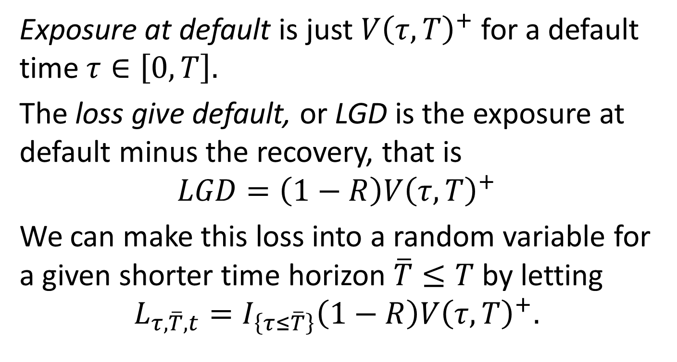
Types of Exposure, cont’d
Exposure at default is just $V{\left(τ,T\right)}^{+}$ for a default time $τ∈\left[0,T\right].$
The loss give default, or LGD is the exposure at default minus the recovery, that is
$$LGD=\left(1−R\right)V{\left(τ,T\right)}^{+}$$
We can make this loss into a random variable for a given shorter time horizon $\overline{T}≤T$ by letting
$$L_{τ,\overline{T},t}=I_{\left\{τ≤\overline{T}\right\}}\left(1−R\right)V{\left(τ,T\right)}^{+}.$$

Slide 7
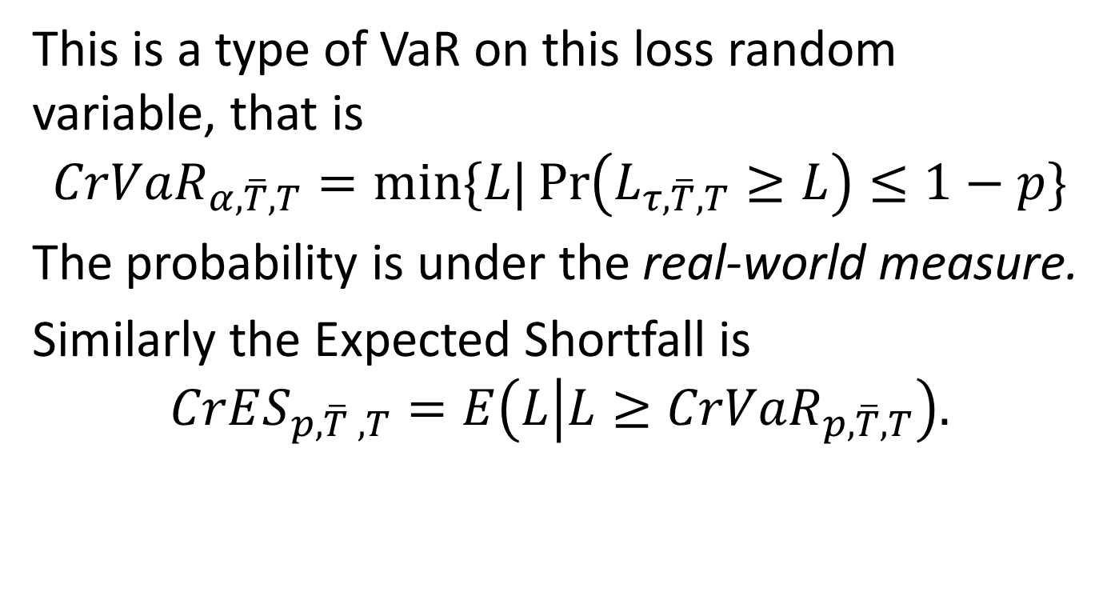
Credit Value at Risk and Expected Shortfall
This is a type of VaR on this loss random variable, that is
$$CrVaR_{α,\overline{T},T}=min⁡\{L|\operatorname{Pr}\left(L_{τ,\overline{T},T}≥L\right)≤1−p\}$$
The probability is under the real-world measure.
Similarly the Expected Shortfall is
$$CrES_{p,\overline{T} ,T}=E\left(L | L≥CrVaR_{p,\overline{T},T}\right).$$

Slide 8
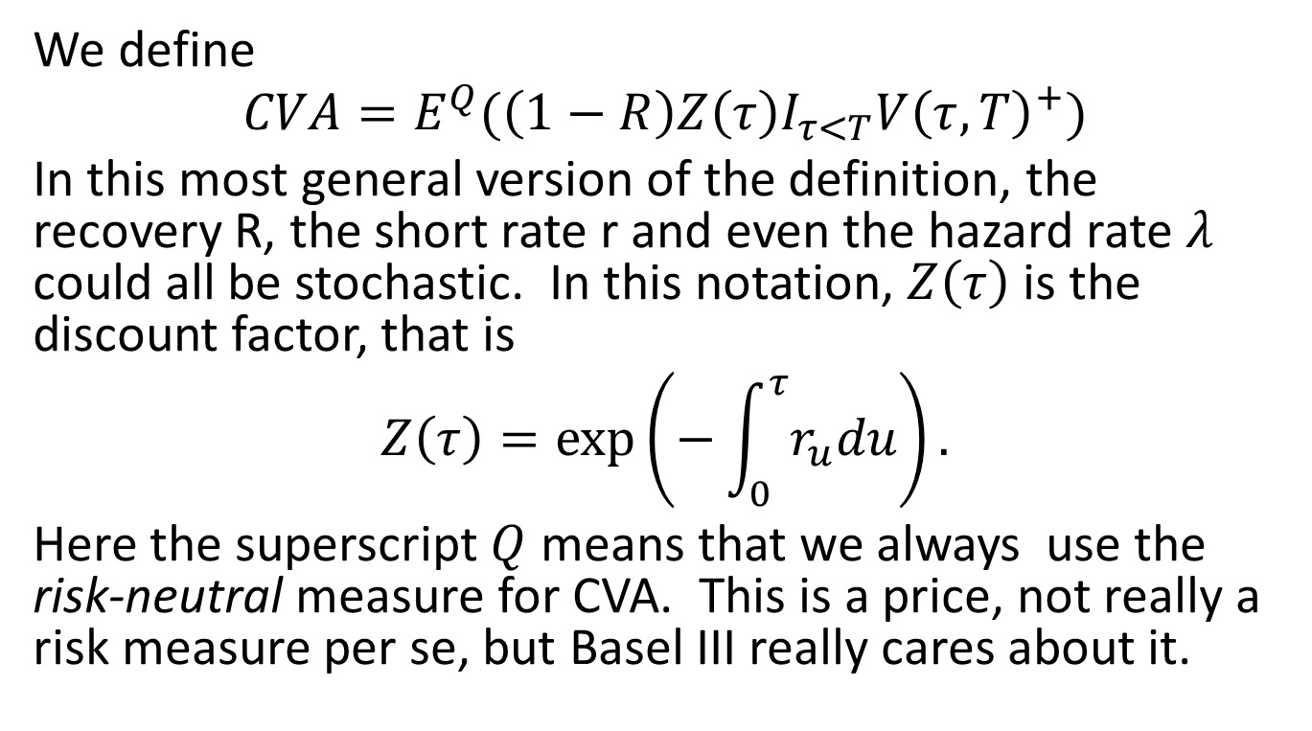
Counterparty Credit Valuation Adjustment (CVA)
We define
$$CVA=E^{Q}(\left(1−R\right)Z\left(τ\right)I_{τ<T}V{\left(τ,T\right)}^{+})$$
In this most general version of the definition, the recovery R, the short rate r and even the hazard rate $λ$ could all be stochastic. In this notation, $Z\left(τ\right)$ is the discount factor, that is
$$Z\left(τ\right)=\exp\left(−\int_{0}^{τ}{r_{u}du}\right).$$
Here the superscript $Q$ means that we always use the risk-neutral measure for CVA. This is a price, not really a risk measure per se, but Basel III really cares about it.

Slide 9
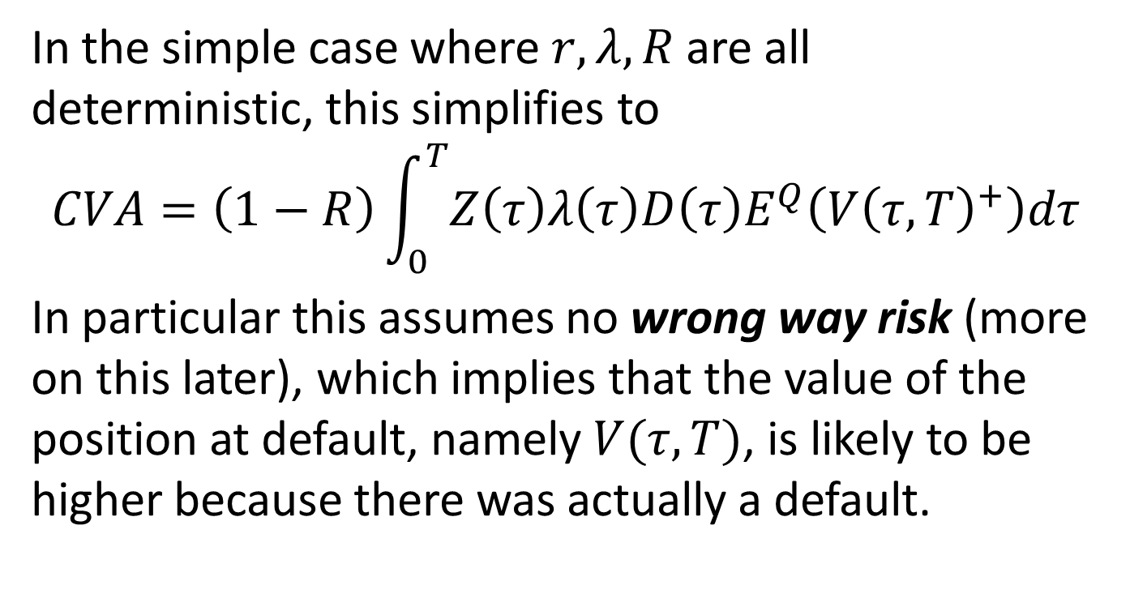
CVA, continued
In the simple case where $r,λ,R$ are all deterministic, this simplifies to
$$CVA=\left(1−R\right)\int_{0}^{T}{Z\left(τ\right)λ\left(τ\right)D\left(τ\right)E^{Q}\left(V{\left(τ,T\right)}^{+}\right)dτ}$$
In particular this assumes no wrong way risk (more on this later), which implies that the value of the position at default, namely $V(τ,T)$, is likely to be higher because there was actually a default.

Slide 10
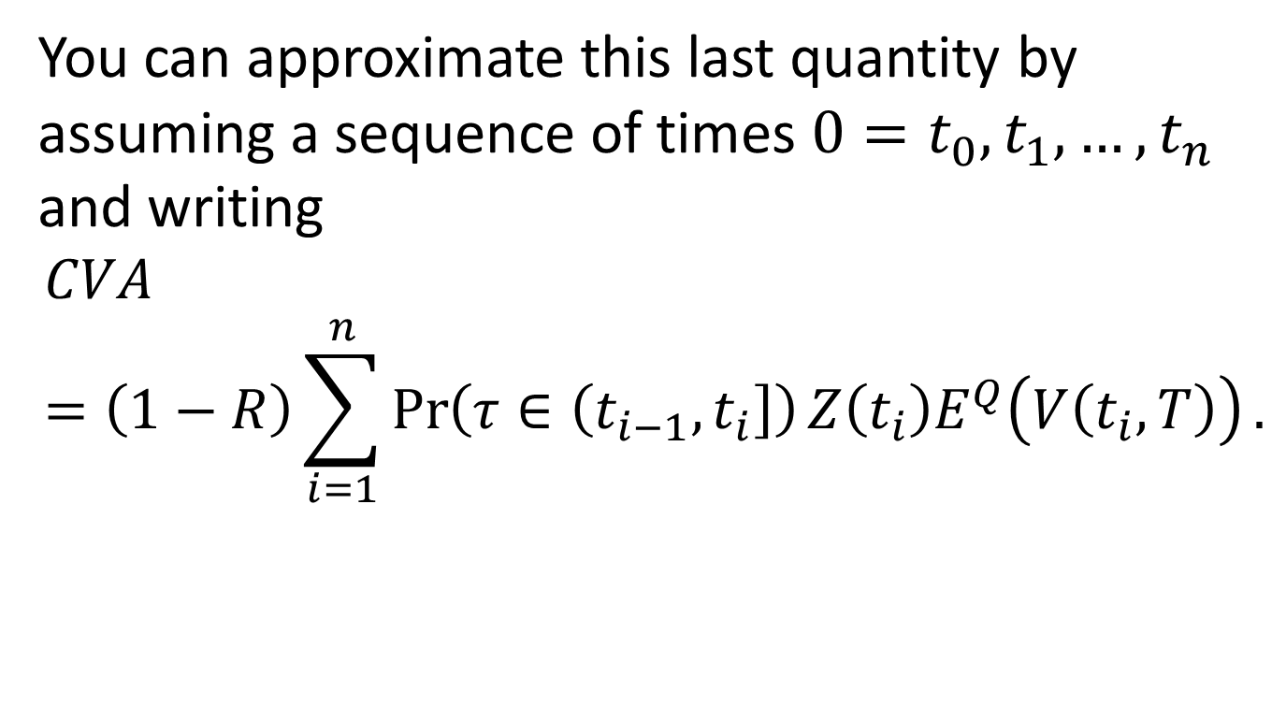
CVA, continued
You can approximate this last quantity by assuming a sequence of times $0=t_{0},t_{1},…,t_{n}$ and writing
$$CVA=\left(1−R\right)\sum_{i=1}^{n}{\operatorname{Pr}\left(τ∈\left(t_{i−1},t_{i}\right]\right)Z\left(t_{i}\right)E^{Q}\left(V\left(t_{i},T\right)\right)}.$$

Slide 11
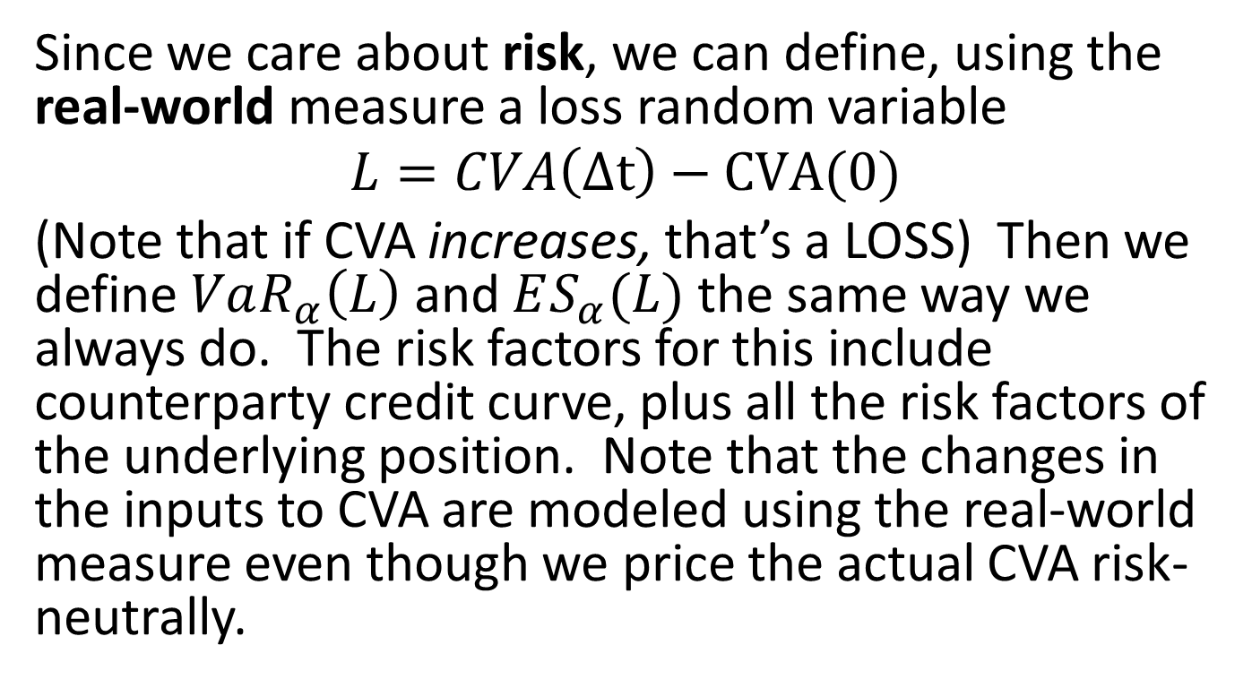
CVA VaR
Since we care about risk, we can define, using the real-world measure a loss random variable
$$L=CVA\left(Δt\right)−CVA(0)$$
(Note that if CVA increases, that’s a LOSS) Then we define $VaR_{α}\left(L\right)$ and $ES_{α}(L)$ the same way we always do. The risk factors for this include counterparty credit curve, plus all the risk factors of the underlying position. Note that the changes in the inputs to CVA are modeled using the real-world measure even though we price the actual CVA risk-neutrally.

Slide 12

What about Collateral?
If the counterparty posts constant collateral C, the formulas change by replacing $V{\left(t,T\right)}^{+}$ with ${\left(V\left(t,T\right)−C\right)}^{+}$ everywhere you see the former.

Slide 13
Debit Valuation Adjustment (DVA)
Just like CVA except that DVA is the adjustment to the position’s value based on your own bank’s risk of default. DVA increases the value of the position to the bank, as opposed to CVA.
In 2008, Morgan Stanley reported a large positive uptick in earnings because their credit spreads widened and their total DVA went up.
I have a real problem with this. Could someone tell me why??

Slide 14
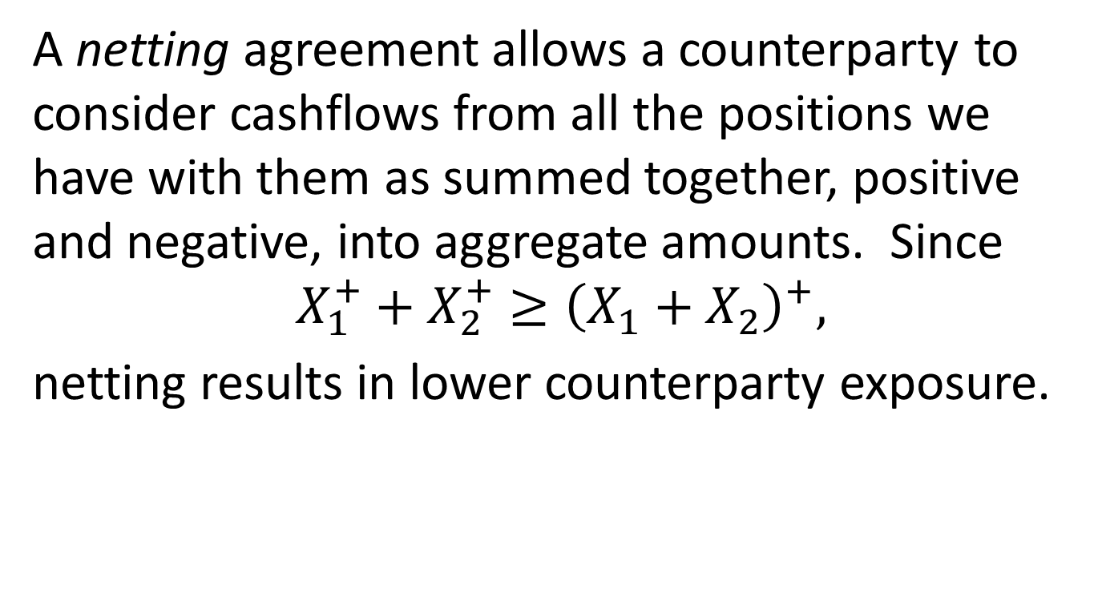
Effect of Netting
A netting agreement allows a counterparty to consider cashflows from all the positions we have with them as summed together, positive and negative, into aggregate amounts. Since
$$X_{1}^{+}+X_{2}^{+}≥{\left(X_{1}+X_{2}\right)}^{+},$$
netting results in lower counterparty exposure.

Slide 15
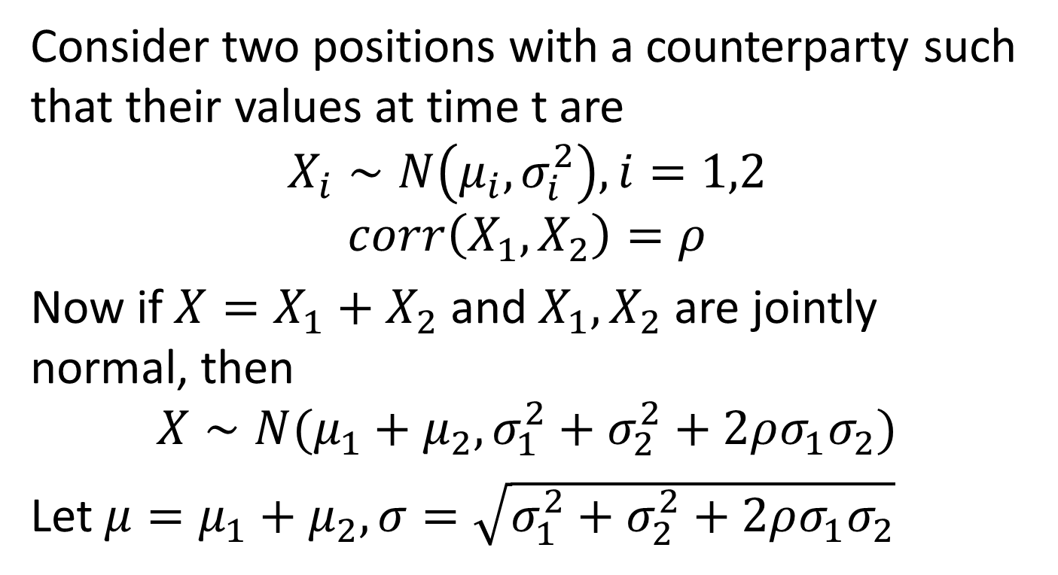
Effect of Netting, continued
Consider two positions with a counterparty such that their values at time t are
$$X_{i}∼N\left(μ_{i},σ_{i}^{2}\right),i=1,2$$
$$corr\left(X_{1},X_{2}\right)=ρ$$
Now if $X=X_{1}+X_{2}$ and $X_{1},X_{2}$ are jointly normal, then
$$X∼N(μ_{1}+μ_{2},σ_{1}^{2}+σ_{2}^{2}+2ρσ_{1}σ_{2})$$
Let $μ=μ_{1}+μ_{2}, σ=\sqrt{σ_{1}^{2}+σ_{2}^{2}+2ρσ_{1}σ_{2}}$

Slide 16
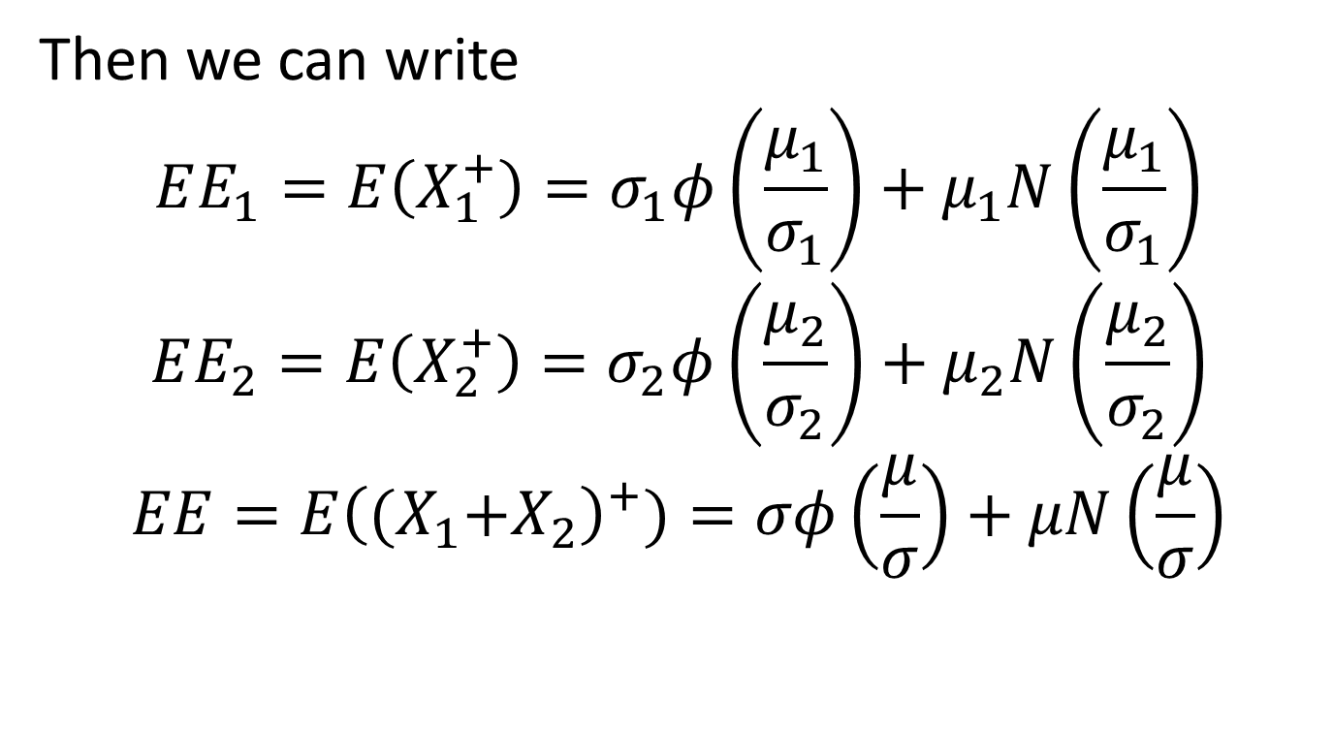
Netting, continued
Then we can write
$$EE_{1}=E\left(X_{1}^{+}\right)=σ_{1}φ\left(\frac{μ_{1}}{σ_{1}}\right)+μ_{1}N\left(\frac{μ_{1}}{σ_{1}}\right)$$
$$EE_{2}=E\left(X_{2}^{+}\right)=σ_{2}φ\left(\frac{μ_{2}}{σ_{2}}\right)+μ_{2}N\left(\frac{μ_{2}}{σ_{2}}\right)$$
$$EE=E{\left({(X}_{1}+X_{2}\right)}^{+})=σφ\left(\frac{μ}{σ}\right)+μN\left(\frac{μ}{σ}\right)$$

Slide 17
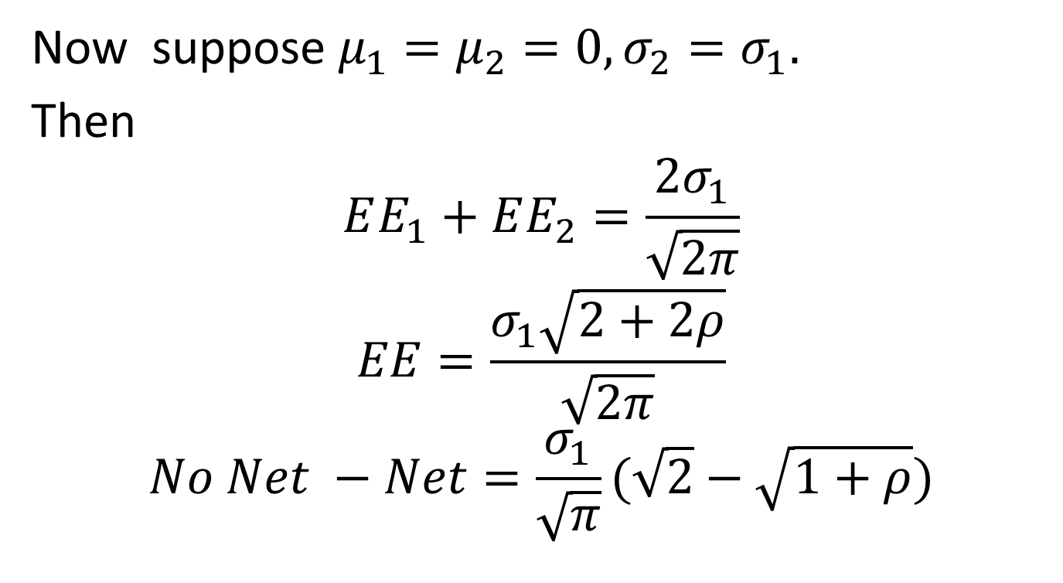
Netting, continued
Now suppose $μ_{1}=μ_{2}=0, σ_{2}=σ_{1}.$
Then
$$EE_{1}+EE_{2}=\frac{2σ_{1}}{\sqrt{2π}}$$
$$EE=\frac{σ_{1}\sqrt{2+2ρ}}{\sqrt{2π}}$$
$$No Net −Net=\frac{σ_{1}}{\sqrt{π}}(\sqrt{2}−\sqrt{1+ρ})$$

Slide 18
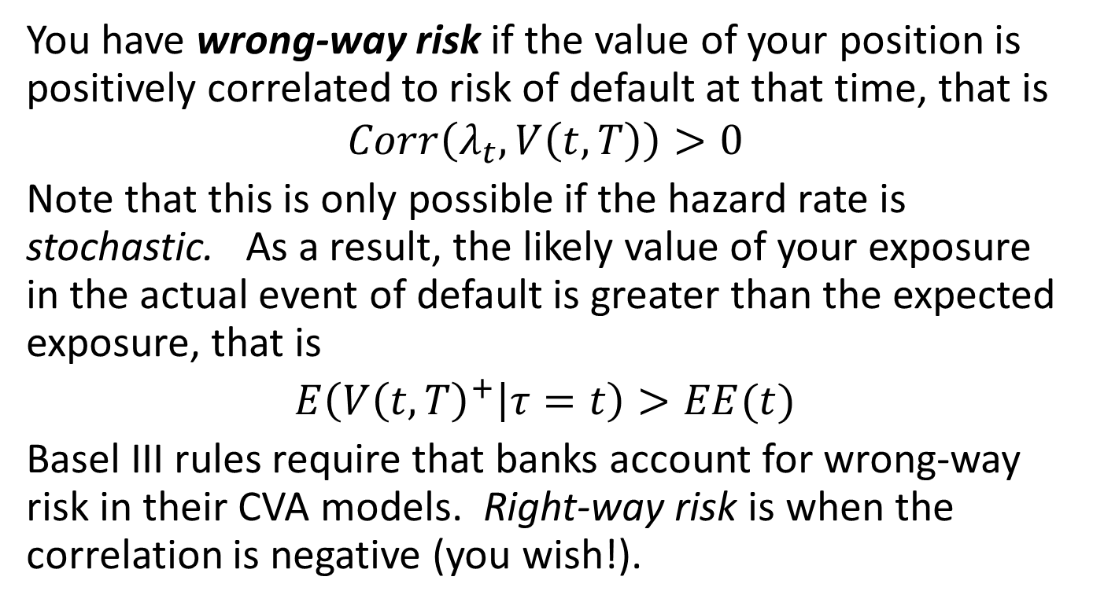
Wrong-Way Risk
You have wrong-way risk if the value of your position is positively correlated to risk of default at that time, that is
$$Corr\left(λ_{t},V\left(t,T\right)\right)>0$$
Note that this is only possible if the hazard rate is stochastic. As a result, the likely value of your exposure in the actual event of default is greater than the expected exposure, that is
$E\left(V{\left(t,T\right)}^{+} | τ=t\right)>EE(t)$
Basel III rules require that banks account for wrong-way risk in their CVA models. Right-way risk is when the correlation is negative (you wish!).

